Slide 1
Engineers with Disabilities
By Joel Robinson
March 16 2012 (without links)
www.sisqa.com

Slide 2
What attributes make a better test engineer?
Tact and Diplomacy
Communications skills tech & non-tech
Judgment Skills
Software experience
Desire for Quality
Attention to detail
Ability to take the customer perspective
Others?

Slide 3
What do test engineers get paid to do?
Write tests – plans, suites, cases, scripts
Run tests – manual, automated,
Communicate – developers, managers, customers
Delegate and manage – 3rd party teams
Document – bugs, fixes, tests, procedures
Implement – integrate and retest
Plan and budget – time, schedule, tasks

Slide 4
Test engineers are not typically paid for lessor important skills like
Social interaction
Verbal skills
Dress for Success
People skills
Management skills

Slide 5
Autism and Asperger's
Not good at selling themselves
Poor interviewers
Handling stress
How to remove the divide between people & employers
How to turn disabilities into special abilities

Slide 6
Specialisterne
New York Times June 30 2011 “Specialisterne”
Danish company now in US, http://specialistpeople.com/
Founder Thorkil Sonne, child with autism
Goal: 1,000,000 people employed
  Asperger’s Syndrome & High functioning Autism
  “If others could appreciate his [son’s] skills and respect his special personality in a meaningful and productive job, then we [parents]could go to the grave with a good conscience.”

Slide 7
Special Abilities
Quality control – seeing something is wrong
Passion for details
Visualization - Comparison of items
Superlative technical aptitudes
Thrive in repetitive tasks, lack of boredom
Strong memory, high focus on tasks
Data Entry, gathering details
Superior ability to spot irregularities

Slide 8
Who invents stuff anyway?
Without the genes that give rise to autism, … the world would be full of charming people who sit around the campfire, chatting gaily and empathizing mightily but inventing nothing. Dr. Temple Grandin

Slide 9
Why do you care?
Trend is for likelihood of more not less in society http://spectrum.ieee.org/biomedical/diagnostics/engineers-and-autism
Engineers are twice as likely as others to have autistic children. Why?
  Engineers score high on systemizing
  Relatives of autistic people tend to score above the average on tests of systemizing
  (Rule based systematic thought, such as those governing computers and machinery)
Due to both sexes in engineering work and schools, raises the chances that people of like minds will marry and bear children. Baron-Cohen, says that such ”assortative mating” is concentrating the genes that predispose to systemizing thought. That, in turn, ought to be increasing the likelihood of having a child with the most extreme systemizing: autism.
Silicon Valley has high proportion of autistic children of engineers.
One percent nationwide, only small portion of adults are employed

Slide 10
What about your boss?
Mark Zuckerberg? Einstein? Tessler?
video
Temple Grandin On Mark Zuckerberg and Overcoming Autism

Slide 11
Special Struggles
People with A.S.D. have problems imagining other people’s feelings and grasping social contexts; they struggle or may be unable to read social cues like facial expressions or sarcasm. They usually have narrowly defined interests, engage in repetitive behaviors, and are resistant to changes in routine. And they are highly sensitive to stress and vulnerable to depression….
In the working world, …[his] biggest problem was communication. (NYT 6/30/2011)

Slide 12
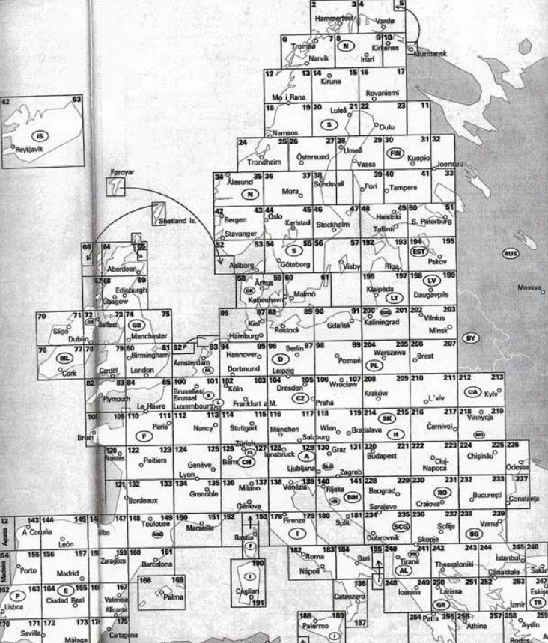
Atlas
Take
30 seconds
To view
Iceland
And Italy

Slide 13
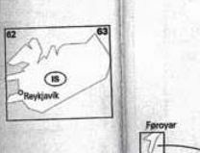
Better view of Iceland

Slide 14
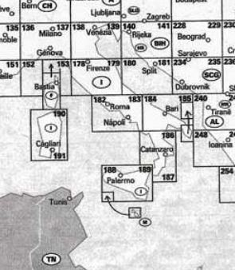
Better view Italy

Slide 15
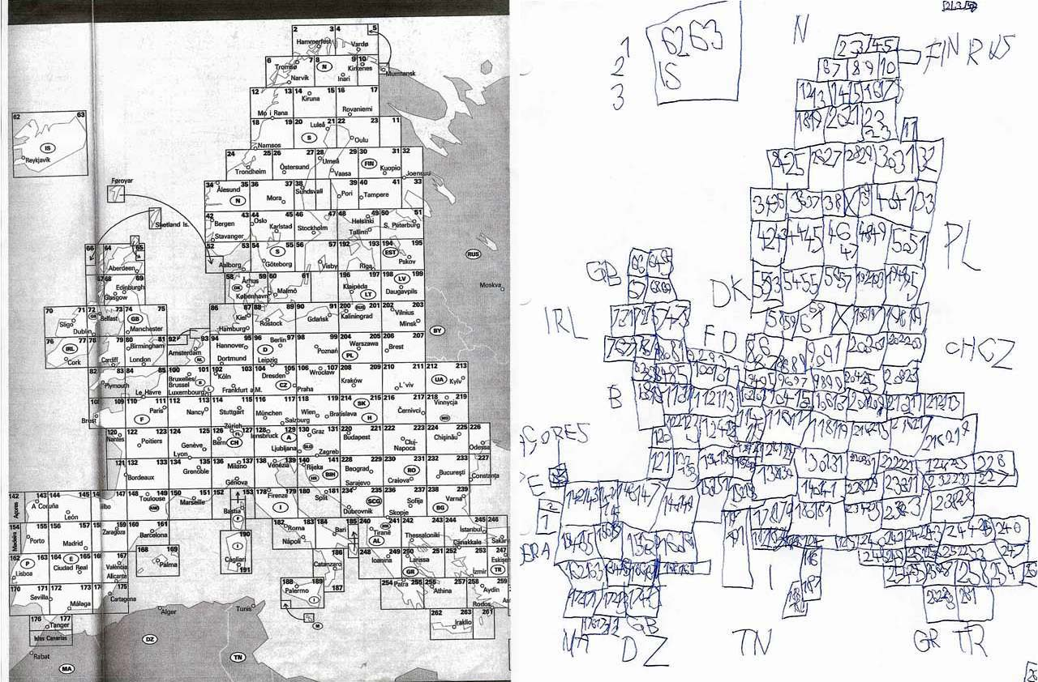
Special Skills 7 year old boy drawn from memory

Slide 16
Interviewing Engineers with Autistic Disabilities
Many have good educations, IT degrees
Don’t handle interviews well
Can’t look someone in the eye
Don’t want to shake hands, say “Hello”
No small talk, don’t get jokes or humor
Anxiety and high stress, Body hygiene
Part-time rather than full time

Slide 17
Managing Engineers with Autistic Disabilities
Be Specific in your direction
Provide quiet work environments, shielded from noise, colors, lights, unexpected events
Avoid long meetings, verbal arguments
Use text for most communications
Expect meticulous in execution and reports
Won’t take a shortcut or ‘fake it’
Won’t say “No” to overbooked workloads

Slide 18
Aspirtech.org (1)
Provides path for high functioning individuals to gainful employment.
Compatibility Testing – ensuring compatibility between multiple applications, web browsers, operating systems, and/or hardware devices.
Functional Testing – verifying that applications and web sites behave according to specification.
Regression Testing – ensuring that defects were not introduced as a result of upgrades, bug fixes, or new feature development.
Test Case & Test Script Development – to form the basis for compatibility, functional, and regression testing.

Slide 19
Aspirtech.org (2)
Provides path for high functioning individuals to gainful employment.
Compatibility Testing – ensuring compatibility between multiple applications, web browsers, operating systems, and/or hardware devices.
Functional Testing – verifying that applications and web sites behave according to specification.
Regression Testing – ensuring that defects were not introduced as a result of upgrades, bug fixes, or new feature development.
Test Case & Test Script Development – to form the basis for compatibility, functional, and regression testing.

Slide 20
Different but not less
Temple Grandin Trailer
Temple Grandin Thinking in Pictures video

Slide 21
21st Century Communications & Video Accessibility Act of 2010
Ensure access to the Web through improved user interfaces for smart phones;
Enable Americans who are blind to enjoy TV more fully through audible descriptions of on-screen action;
Ensure that TV program guides and selection menus are also accessible to people with vision loss;
Provide Americans who are deaf the ability to watch new TV programs which are aired online to include captions;
Mandate that remote controls have a button to easily access the closed captioning on broadcast and pay TV;
Require that telecom equipment used to make calls over the Internet is compatible with hearing aids;

Slide 22
Americans with Disability Act
The employment provisions of the ADA apply to businesses that have 15 or more employees on the payroll.
The ADA protects a person with a disability who is qualified for the job.
The ADA requires employers to provide reasonable accommodation to a qualified person with a disability unless to do so would be an "undue hardship."
Undue hardship means significant difficulty or expense. A requested reasonable accommodation poses an undue hardship if:
  it involves a significant difficulty that disrupts the business;
  it involves a significant expense; or
  it requires the employer to change the basic nature of its business.

